Slide 1
Lecture 3 – Hadoop Technical Introduction
CSE 490H

Slide 2
Announcements
My office hours: M 2:30—3:30 in CSE 212
Cluster is operational; instructions in assignment 1 heavily rewritten
Eclipse plugin is “deprecated”
Students who already created accounts: let me know if you have trouble

Slide 3
Breaking news!
Hadoop tested on 4,000 node cluster
  32K cores (8 / node)
  16 PB raw storage (4 x 1 TB disk / node)
    (about 5 PB usable storage)
http://developer.yahoo.com/blogs/hadoop/2008/09/
scaling_hadoop_to_4000_nodes_a.html

Slide 4
You Say, “tomato…”
Google calls it: | Hadoop equivalent:
MapReduce | Hadoop
GFS | HDFS
Bigtable | HBase
Chubby | Zookeeper

Slide 5
Some MapReduce Terminology
Job – A “full program” - an execution of a Mapper and Reducer across a data set
Task – An execution of a Mapper or a Reducer on a slice of data
  a.k.a. Task-In-Progress (TIP)
Task Attempt – A particular instance of an attempt to execute a task on a machine

Slide 6
Terminology Example
Running “Word Count” across 20 files is one job
20 files to be mapped imply 20 map tasks + some number of reduce tasks
At least 20 map task attempts will be performed… more if a machine crashes, etc.

Slide 7
Task Attempts
A particular task will be attempted at least once, possibly more times if it crashes
  If the same input causes crashes over and over, that input will eventually be abandoned
Multiple attempts at one task may occur in parallel with speculative execution turned on
  Task ID from TaskInProgress is not a unique identifier; don’t use it that way

Slide 8
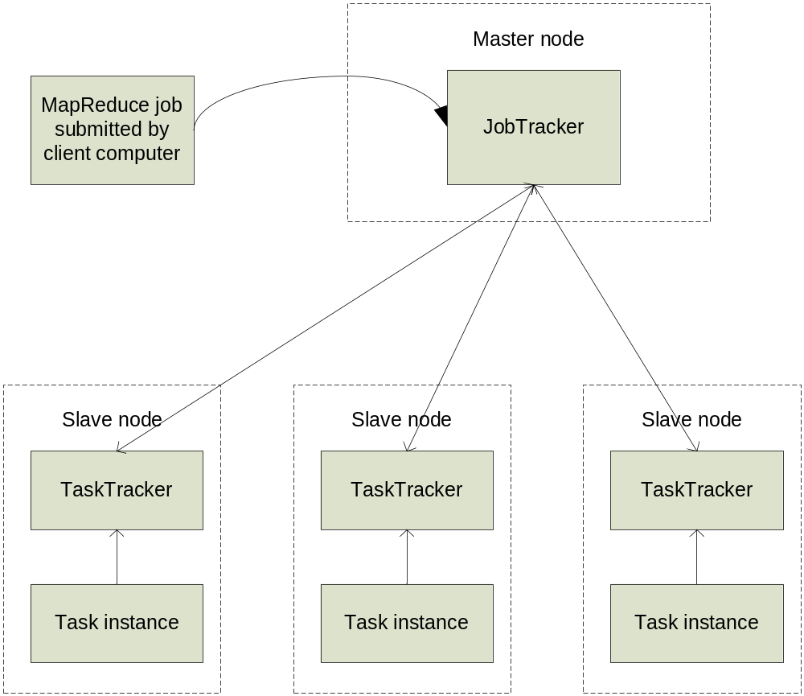
MapReduce: High Level

Slide 9
Node-to-Node Communication
Hadoop uses its own RPC protocol
All communication begins in slave nodes
  Prevents circular-wait deadlock
  Slaves periodically poll for “status” message
Classes must provide explicit serialization

Slide 10
Nodes, Trackers, Tasks
Master node runs JobTracker instance, which accepts Job requests from clients
TaskTracker instances run on slave nodes
TaskTracker forks separate Java process for task instances

Slide 11
Job Distribution
MapReduce programs are contained in a Java “jar” file + an XML file containing serialized program configuration options
Running a MapReduce job places these files into the HDFS and notifies TaskTrackers where to retrieve the relevant program code
… Where’s the data distribution?

Slide 12
Data Distribution
Implicit in design of MapReduce!
  All mappers are equivalent; so map whatever data is local to a particular node in HDFS
If lots of data does happen to pile up on the same node, nearby nodes will map instead
  Data transfer is handled implicitly by HDFS

Slide 13
Configuring With JobConf
MR Programs have many configurable options
JobConf objects hold (key, value) components mapping String → ’a
  e.g., “mapred.map.tasks” → 20
  JobConf is serialized and distributed before running the job
Objects implementing JobConfigurable can retrieve elements from a JobConf

Slide 14
What Happens In MapReduce?
Depth First

Slide 15
Job Launch Process: Client
Client program creates a JobConf
  Identify classes implementing Mapper and Reducer interfaces
    JobConf.setMapperClass(), setReducerClass()
  Specify inputs, outputs
    FileInputFormat.addInputPath(),
    FileOutputFormat.setOutputPath()
  Optionally, other options too:
    JobConf.setNumReduceTasks(), JobConf.setOutputFormat()…

Slide 16
Job Launch Process: JobClient
Pass JobConf to JobClient.runJob() or submitJob()
  runJob() blocks, submitJob() does not
JobClient:
  Determines proper division of input into InputSplits
  Sends job data to master JobTracker server

Slide 17
Job Launch Process: JobTracker
JobTracker:
  Inserts jar and JobConf (serialized to XML) in shared location
  Posts a JobInProgress to its run queue

Slide 18
Job Launch Process: TaskTracker
TaskTrackers running on slave nodes periodically query JobTracker for work
Retrieve job-specific jar and config
Launch task in separate instance of Java
  main() is provided by Hadoop

Slide 19
Job Launch Process: Task
TaskTracker.Child.main():
  Sets up the child TaskInProgress attempt
  Reads XML configuration
  Connects back to necessary MapReduce components via RPC
  Uses TaskRunner to launch user process

Slide 20
Job Launch Process: TaskRunner
TaskRunner, MapTaskRunner, MapRunner work in a daisy-chain to launch your Mapper
  Task knows ahead of time which InputSplits it should be mapping
  Calls Mapper once for each record retrieved from the InputSplit
Running the Reducer is much the same

Slide 21
Creating the Mapper
You provide the instance of Mapper
  Should extend MapReduceBase
One instance of your Mapper is initialized by the MapTaskRunner for a TaskInProgress
  Exists in separate process from all other instances of Mapper – no data sharing!

Slide 22
Mapper
void map(K1 key,
  V1 value,
  OutputCollector<K2, V2> output,
  Reporter reporter)
K types implement WritableComparable
V types implement Writable

Slide 23
What is Writable?
Hadoop defines its own “box” classes for strings (Text), integers (IntWritable), etc.
All values are instances of Writable
All keys are instances of WritableComparable

Slide 24
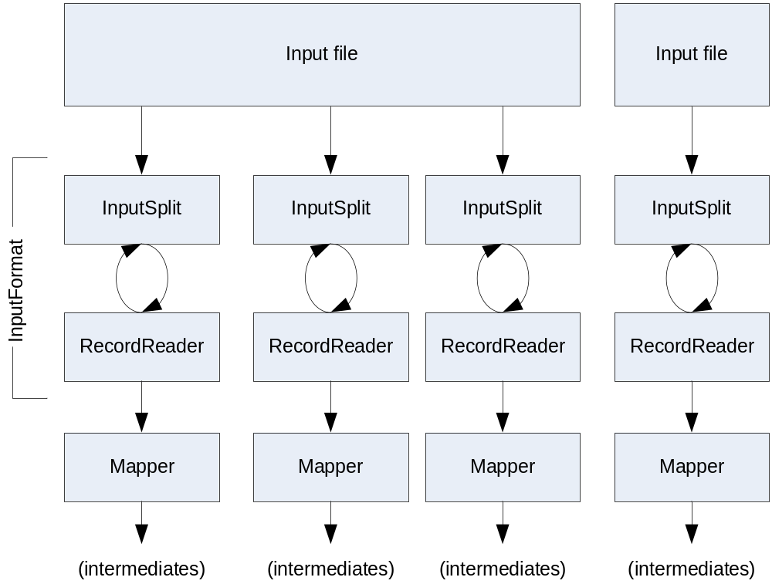
Getting Data To The Mapper

Slide 25
Reading Data
Data sets are specified by InputFormats
  Defines input data (e.g., a directory)
  Identifies partitions of the data that form an InputSplit
  Factory for RecordReader objects to extract (k, v) records from the input source

Slide 26
FileInputFormat and Friends
TextInputFormat – Treats each ‘\n’-terminated line of a file as a value
KeyValueTextInputFormat – Maps ‘\n’- terminated text lines of “k SEP v”
SequenceFileInputFormat – Binary file of (k, v) pairs with some add’l metadata
SequenceFileAsTextInputFormat – Same, but maps (k.toString(), v.toString())

Slide 27
Filtering File Inputs
FileInputFormat will read all files out of a specified directory and send them to the mapper
Delegates filtering this file list to a method subclasses may override
  e.g., Create your own “xyzFileInputFormat” to read *.xyz from directory list

Slide 28
Record Readers
Each InputFormat provides its own RecordReader implementation
  Provides (unused?) capability multiplexing
LineRecordReader – Reads a line from a text file
KeyValueRecordReader – Used by KeyValueTextInputFormat

Slide 29
Input Split Size
FileInputFormat will divide large files into chunks
  Exact size controlled by mapred.min.split.size
RecordReaders receive file, offset, and length of chunk
Custom InputFormat implementations may override split size – e.g., “NeverChunkFile”

Slide 30
Sending Data To Reducers
Map function receives OutputCollector object
  OutputCollector.collect() takes (k, v) elements
Any (WritableComparable, Writable) can be used
By default, mapper output type assumed to be same as reducer output type

Slide 31
WritableComparator
Compares WritableComparable data
  Will call WritableComparable.compare()
  Can provide fast path for serialized data
JobConf.setOutputValueGroupingComparator()

Slide 32
Sending Data To The Client
Reporter object sent to Mapper allows simple asynchronous feedback
  incrCounter(Enum key, long amount)
  setStatus(String msg)
Allows self-identification of input
  InputSplit getInputSplit()

Slide 33
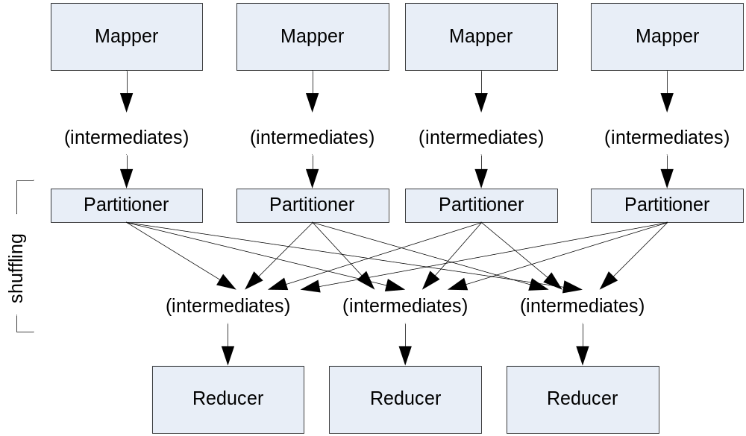
Partition And Shuffle

Slide 34
Partitioner
int getPartition(key, val, numPartitions)
  Outputs the partition number for a given key
  One partition == values sent to one Reduce task
HashPartitioner used by default
  Uses key.hashCode() to return partition num
JobConf sets Partitioner implementation

Slide 35
Reduction
reduce( K2 key,
  Iterator<V2> values,
  OutputCollector<K3, V3> output,
  Reporter reporter)
Keys & values sent to one partition all go to the same reduce task
Calls are sorted by key – “earlier” keys are reduced and output before “later” keys

Slide 36
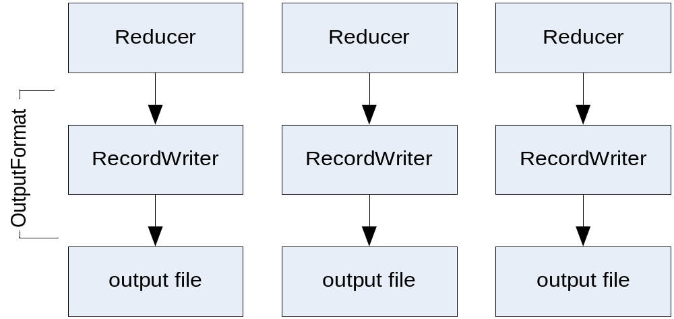
Finally: Writing The Output

Slide 37
OutputFormat
Analogous to InputFormat
TextOutputFormat – Writes “key val\n” strings to output file
SequenceFileOutputFormat – Uses a binary format to pack (k, v) pairs
NullOutputFormat – Discards output

Slide 38
Questions?

